Slide 1
A grassroots civic voice
An effective network
Supporting communities
A channel for information
A voice of scrutiny

Slide 2
“It’s not just the surroundings that make Cambridge special, it’s our wonderful residents that make our city what it is, too”
Jeremy Benstead, Mayor of Cambridge

Slide 3
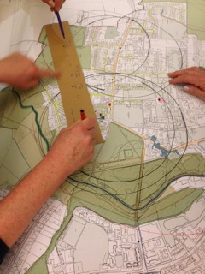
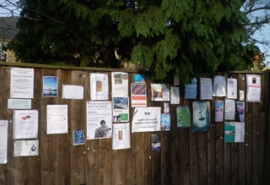
Neighbourhood planning in South Newnham

Slide 4
Romsey Terrace Residents

Slide 5
Steel shutters “mothball” the Romsey homes

Slide 6
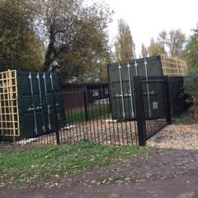
Containers at the Learner Pool, Sheeps Green, also impact on the river environment
indi

Slide 7
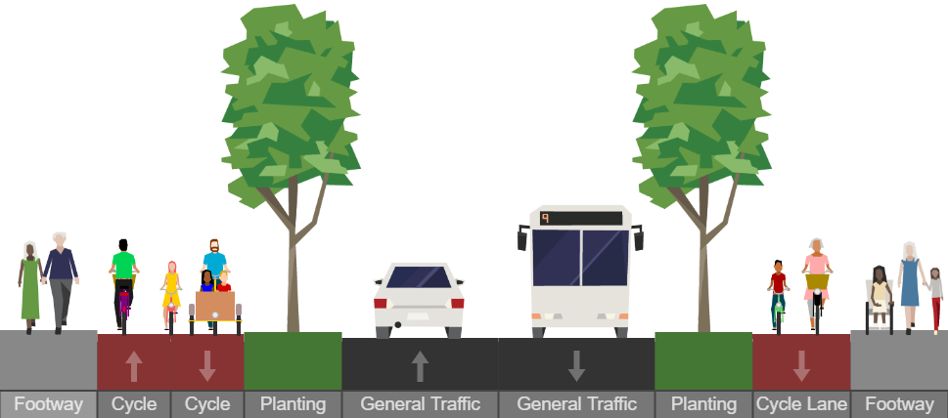
Cambridge residents are great problem solvers. Will MRA’s scheme for Milton Road set a new standard?
The ‘Do-Optimum’ Alternative

Slide 8
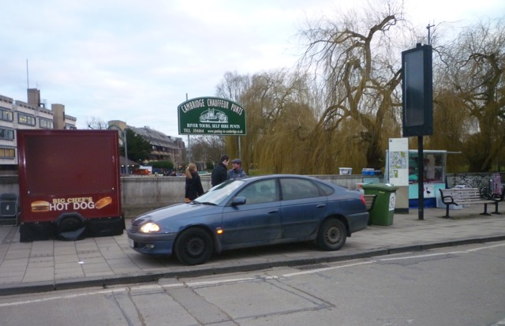
Silver St Bridge, Grade 2 listed, prime Historic Core

Slide 9
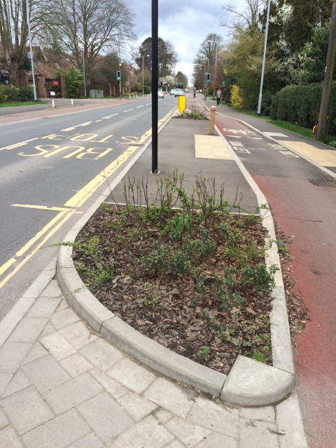
Green city initiatives: New green spaces in Barton Close & Hills Road

